Slide 1
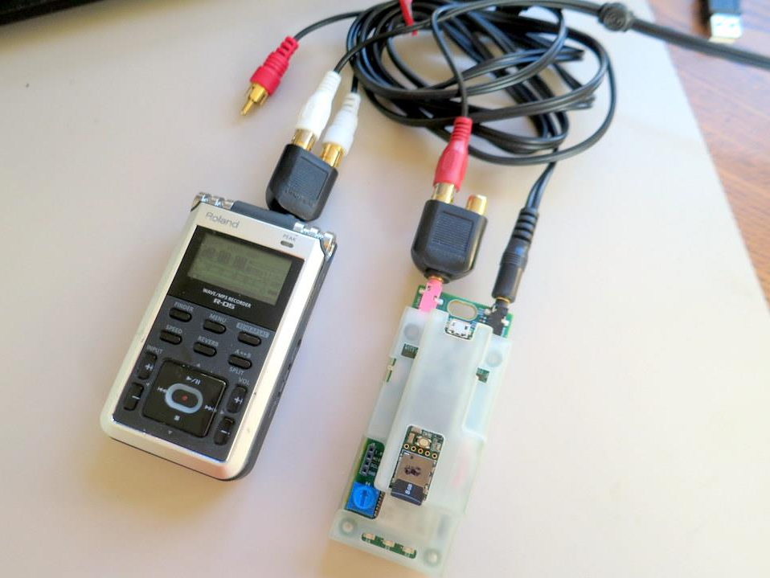
Audio
From PC
Left
Right
Audio Recorder
Input
Output
Tympan

Slide 2
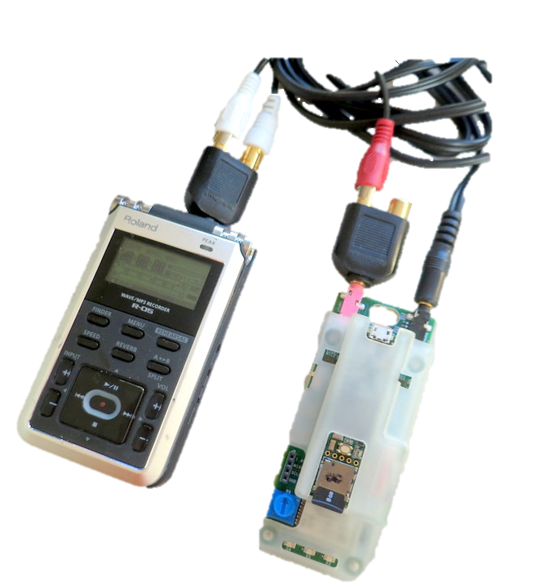
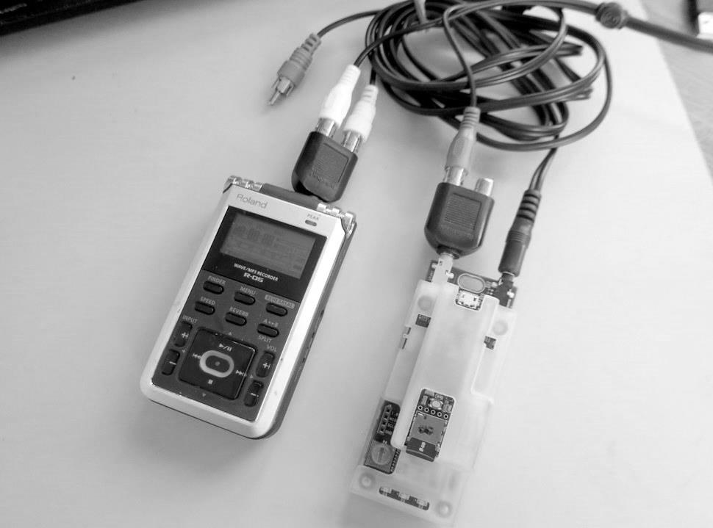
Measuring
Latency
Audio
From PC
Left
Right
Audio Recorder
Input
Output
Tympan

Slide 3
